Slide 1
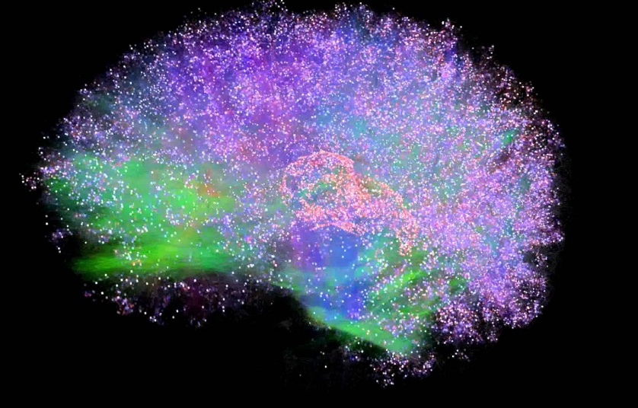
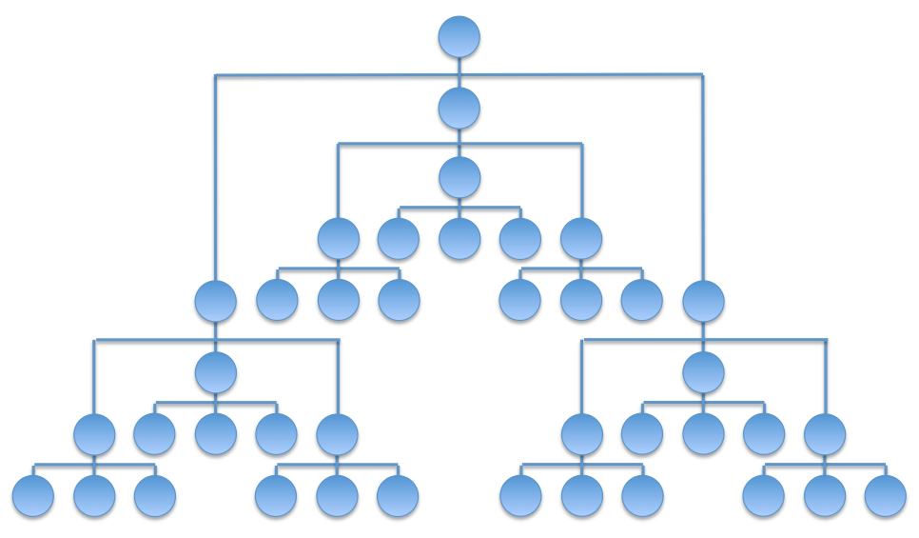
Integrated Information Theory for Organisational Consciousness
Jonathan Peters
Supervisors: Mariano Beguerisse, Christian Bick, Yakov Kremnitzer, Steve Brewis, Steve Cassidy

Slide 2
Integrated Information Theory
Properties of Consciousness
Existence
Composition
Integration
Information
Exclusion
RED

Slide 3
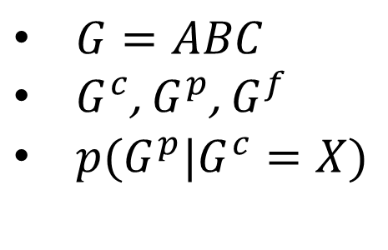
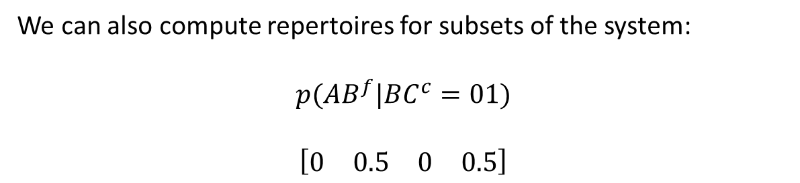

Notation
A
Or
$G=ABC$
$G^{c}$, $G^{p}$, $G^{f}$
$p(G^{p}|G^{c}=X)$
B AND
C
XOR
For example,
$$p(G^{f}|G^{c}=100)$$
$$\left[\begin{matrix}0 & 0 & 0 & 0 & 1 & 0 & 0 & 0\end{matrix}\right]$$
$$\left[\begin{matrix}000 & 100 & 010 & 110 & 001 & 101 & 011 & 111\end{matrix}\right]$$
We can also compute repertoires for subsets of the system:
$$p({AB}^{f}|{BC}^{c}=01)$$
$$\left[\begin{matrix}0 & 0.5 & 0 & 0.5\end{matrix}\right]$$

Slide 4
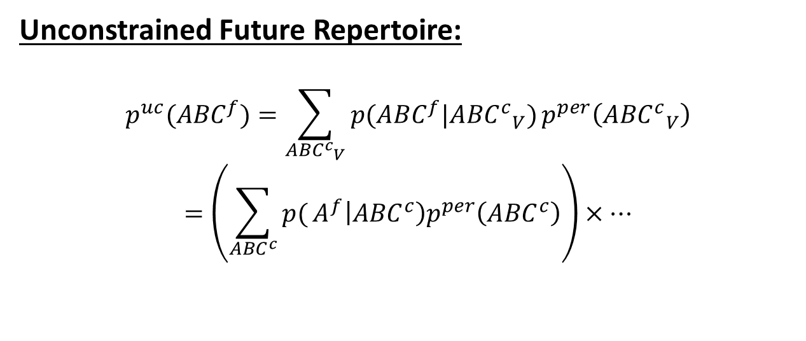
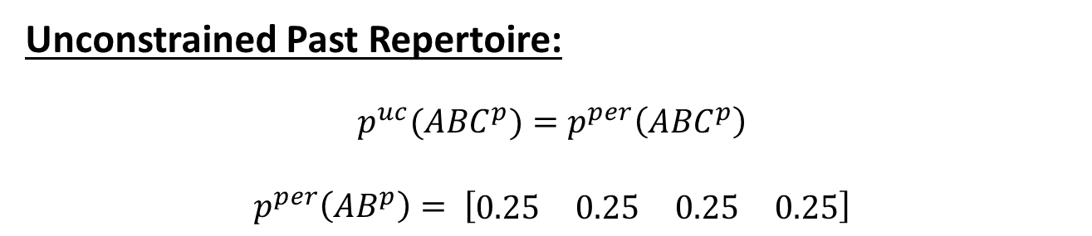
Unconstrained repertoires
Unconstrained Past Repertoire:
$$p^{uc}({ABC}^{p})=p^{per}\left({ABC}^{p}\right)$$
$$p^{per}\left({AB}^{p}\right)= \left[\begin{matrix}0.25 & 0.25 & 0.25 & 0.25\end{matrix}\right]$$
Unconstrained Future Repertoire:
$$p^{uc}({ABC}^{f})=\sum_{{{ABC}^{c}}_{V}}{p({ABC}^{f}|{{ABC}^{c}}_{V})}p^{per}\left({{ABC}^{c}}_{V}\right)$$
$$=\left(\sum_{{ABC}^{c}}{p(}A^{f}\left|{ABC}^{c}\right)p^{per}\left({ABC}^{c}\right)\right)×…$$

Slide 5
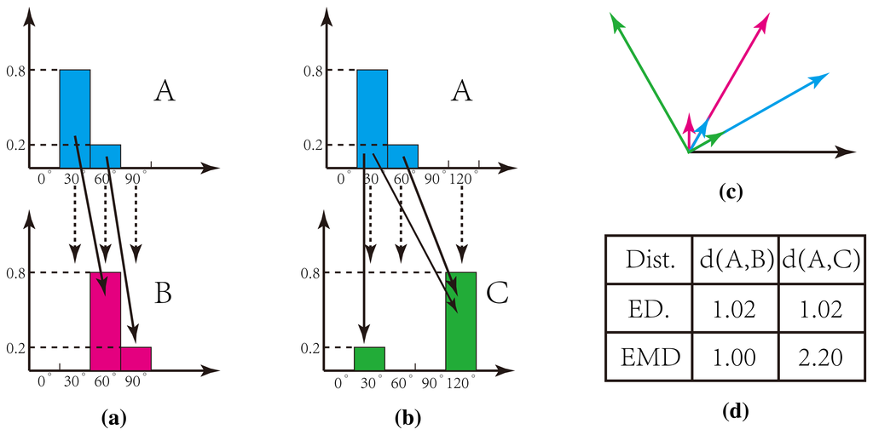
Earth Mover’s Distance

Slide 6
Mechanisms
A Or
B And
C Xor
Existence: The mechanism ABC exists.
Composition: The mechanism ABC is the composition of 3 smaller mechanisms: a 3rd order mechanism.

Slide 7
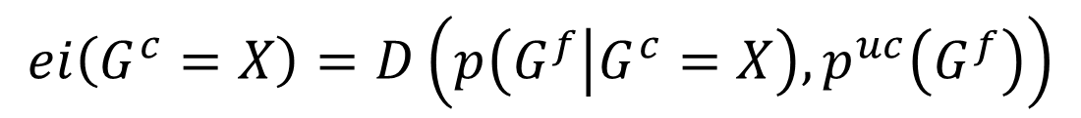
Information
Unconstrained Present
Known Present State
Unconstrained Future
Effect Repertoire
$$ei\left(G^{c}=X\right)=D\left(p\left(G^{f} | G^{c}=X\right), p^{uc}\left(G^{f}\right)\right)$$

Slide 8
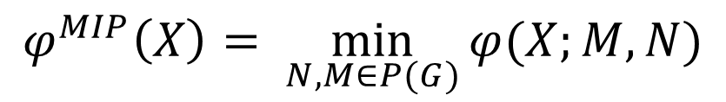

Integration
$${ABC}^{c}/{ABC}^{f}$$
A
A
A
A
B
B
VS
B
B
C
C
C
C
$$φ\left(X;M,N \right)=D\left(p\left(G^{f} | G^{c}=X\right),p\left(M^{f} | N^{c}=X_{N}\right)p\left({G\backslash M}^{f} | {G\backslash N}^{c}=X_{G\backslash N}\right)\right)$$
$$φ^{MIP}\left(X\right)= \min_{N,M∈P(G)}{φ(X;M,N)}$$

Slide 9

Exclusion
What is the core effect of ${AB}^{c}=01$?
A
A
B
B
C
C
Calculate $φ^{MIP}(01)$ for ${AB}^{c}/M^{p}$ for all $M∈P(G)$
The largest value of $φ^{MIP}(01)$ gives $φ^{MAX}\left(01\right).$

Slide 10
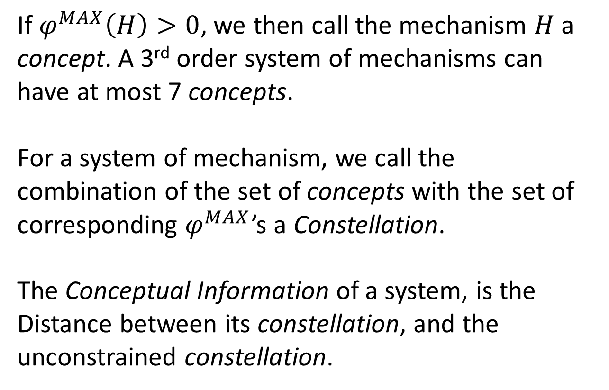
Further Calculations
If $φ^{MAX}\left(H\right)>0$, we then call the mechanism $H$ a concept. A 3rd order system of mechanisms can have at most 7 concepts.
For a system of mechanism, we call the combination of the set of concepts with the set of corresponding $φ^{MAX}$’s a Constellation.
The Conceptual Information of a system, is the Distance between its constellation, and the unconstrained constellation.

Slide 11
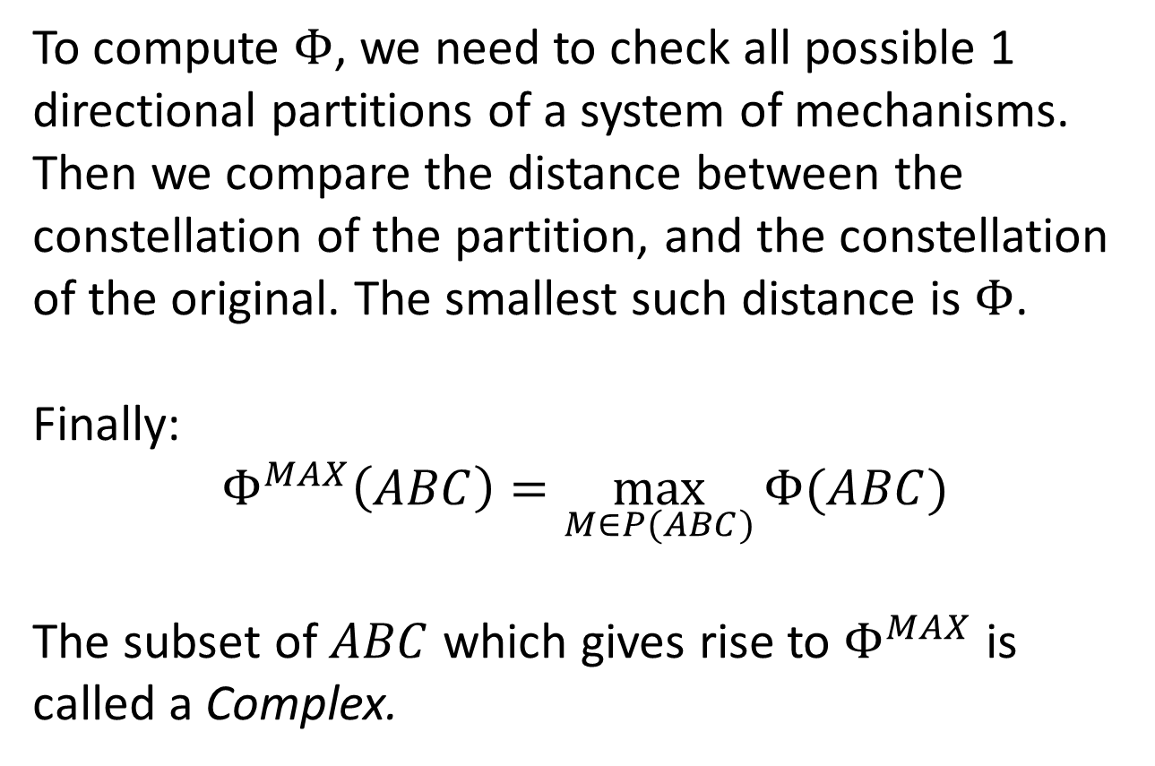
Further Calculations
To compute $Φ$, we need to check all possible 1 directional partitions of a system of mechanisms. Then we compare the distance between the constellation of the partition, and the constellation of the original. The smallest such distance is $Φ$.
Finally:
$$Φ^{MAX}\left(ABC\right)=\max_{M∈P(ABC)}{Φ(ABC)}$$
The subset of $ABC$ which gives rise to $Φ^{MAX}$ is called a Complex.

Slide 12


Computation of $Φ$
Pre-existing software exists to compute $Φ$.
$$T_{ij}=P(G^{t+1}=j|G^{t}=i)$$
ABC | 000 | 100 | 010 | 110 | 001 | 101 | 011 | 111
000 | 1 | 0 | 0 | 0 | 0 | 0 | 0 | 0
100 | 0 | 0 | 0 | 0 | 1 | 0 | 0 | 0
010 | 0 | 0 | 0 | 0 | 0 | 1 | 0 | 0
110 | 0 | 1 | 0 | 0 | 0 | 0 | 0 | 0
001 | 0 | 1 | 0 | 0 | 0 | 0 | 0 | 0
101 | 0 | 0 | 0 | 0 | 0 | 0 | 0 | 1
011 | 0 | 0 | 0 | 0 | 0 | 1 | 0 | 0
111 | 0 | 0 | 0 | 1 | 0 | 0 | 0 | 0

Slide 13
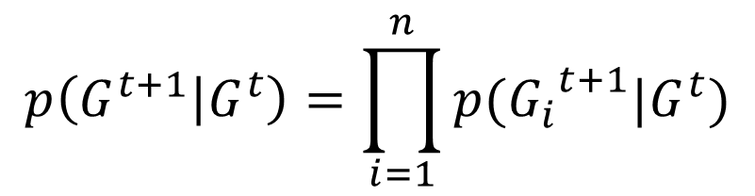

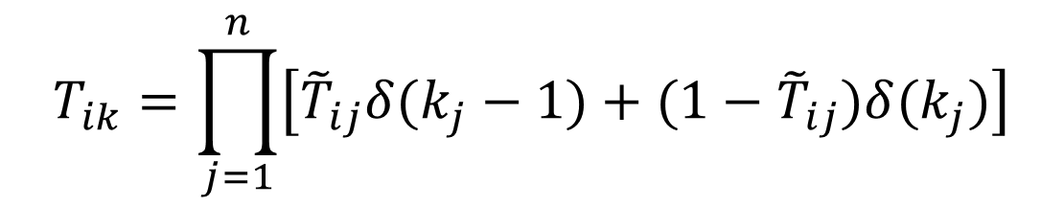
Transition Probability Matrix
$$p\left(G^{t+1} | G^{t}\right)=\prod_{i=1}^{n}{p({G_{i}}^{t+1}|G^{t})}$$
State | A | B | C
000 | 0 | 0 | 0
100 | 0 | 0 | 1
010 | 1 | 0 | 1
110 | 1 | 0 | 0
001 | 1 | 0 | 0
101 | 1 | 1 | 1
011 | 1 | 0 | 1
111 | 1 | 1 | 0
$${\tilde{T}}_{ij}=P({G_{j}}^{t+1}=1|G^{t}=i)$$
$$T_{ik}=\prod_{j=1}^{n}{\left[{\tilde{T}}_{ij}δ(k_{j}−1)+(1−{\tilde{T}}_{ij})δ(k_{j})\right]}$$

Slide 14
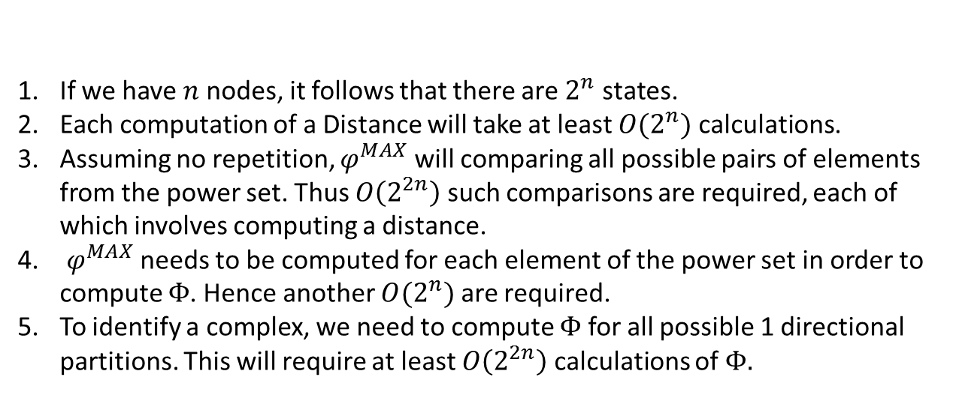

Scalability of $Φ$
If we have $n$ nodes, it follows that there are $2^{n}$ states.
Each computation of a Distance will take at least $O(2^{n})$ calculations.
Assuming no repetition, $φ^{MAX}$ will comparing all possible pairs of elements from the power set. Thus $O\left(2^{2n}\right)$ such comparisons are required, each of which involves computing a distance.
$φ^{MAX}$ needs to be computed for each element of the power set in order to compute $Φ$. Hence another $O(2^{n})$ are required.
To identify a complex, we need to compute $Φ$ for all possible 1 directional partitions. This will require at least $O\left(2^{2n}\right)$ calculations of $Φ.$
Hence we estimate $Φ$ scales with at least $O\left(2^{6n}\right)$.

Slide 15
Model
Properties of the Organisation
Profits are made by completing projects. These projects require the application of certain skills in order to be completed.
Each team/individual within the company possesses at least one skill.
Projects are completed once sufficiently many teams/individuals, which possess all required skills, work on the project for a sufficient length of time.

Slide 16
Simple Model
Assumptions
The number of teams/individuals available is fixed.
The skills possessed by each team/individual are fixed.
With each time-step, a single new project arrives. The skills required by this project are randomly determined.
A
α
Pα
C
Pβ
β
B
Skills
Teams
Projects

Slide 17
Simple Model
A
α
Pα
C
Pβ
β
B
Skills
Teams
Projects
Node Pα is on if an incoming project requires skill α.
Node Pβ is on if an incoming project requires skill β.
These two nodes turn on and off randomly, indicating random project arrival.
Teams possess the skills that they are connected to.
How should teams A, B and C activate and deactivate?

Slide 18
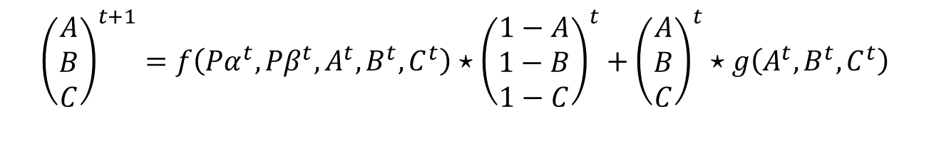
Simple Model
A
α
Pα
C
Pβ
β
B
Skills
Teams
Projects
$${\left(\begin{matrix}A \\ B \\ C\end{matrix}\right)}^{t+1}=f\left({Pα}^{t},{Pβ}^{t},A^{t},B^{t},C^{t}\right)⋆{\left(\begin{matrix}1−A \\ 1−B \\ 1−C\end{matrix}\right)}^{t}+{\left(\begin{matrix}A \\ B \\ C\end{matrix}\right)}^{t}⋆g\left(A^{t},B^{t},C^{t}\right)$$
Node turns on
Node turns off

Slide 19
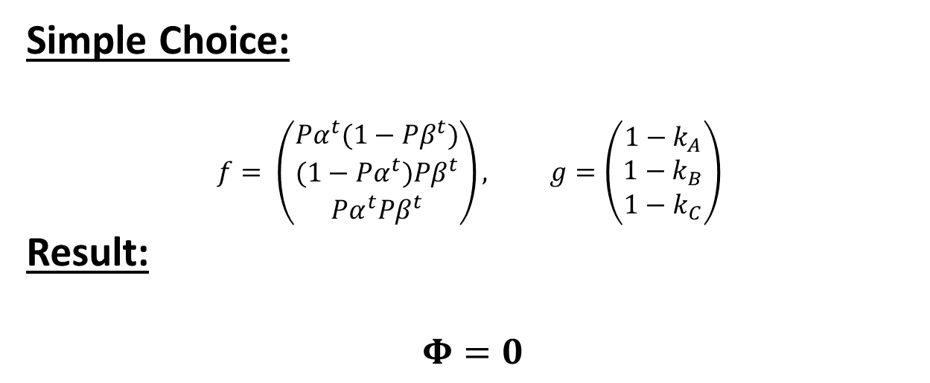
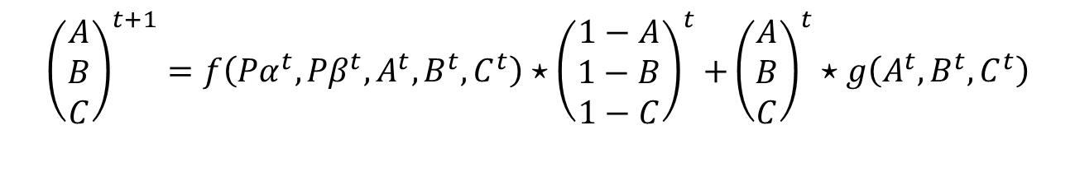
Simple Model
$${\left(\begin{matrix}A \\ B \\ C\end{matrix}\right)}^{t+1}=f\left({Pα}^{t},{Pβ}^{t},A^{t},B^{t},C^{t}\right){⋆\left(\begin{matrix}1−A \\ 1−B \\ 1−C\end{matrix}\right)}^{t}+{\left(\begin{matrix}A \\ B \\ C\end{matrix}\right)}^{t}⋆g\left(A^{t},B^{t},C^{t}\right)$$
Node turns on
Node turns off
Simple Choice:
$$f= \left(\begin{matrix}{Pα}^{t}(1−{Pβ}^{t}) \\ {(1−Pα}^{t}){Pβ}^{t} \\ {Pα}^{t}{Pβ}^{t}\end{matrix}\right), g=\left(\begin{matrix}1−k_{A} \\ 1−k_{B} \\ 1−k_{C}\end{matrix}\right)$$
Result:
$$Φ=0$$

Slide 20
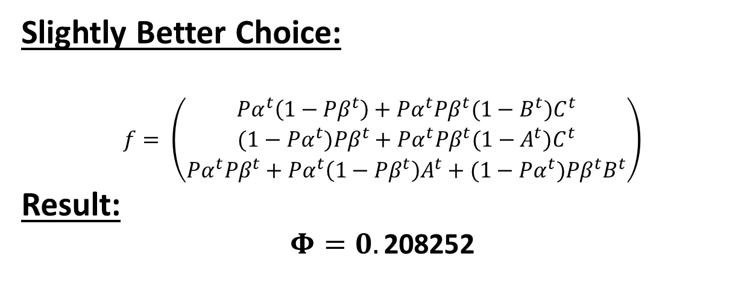
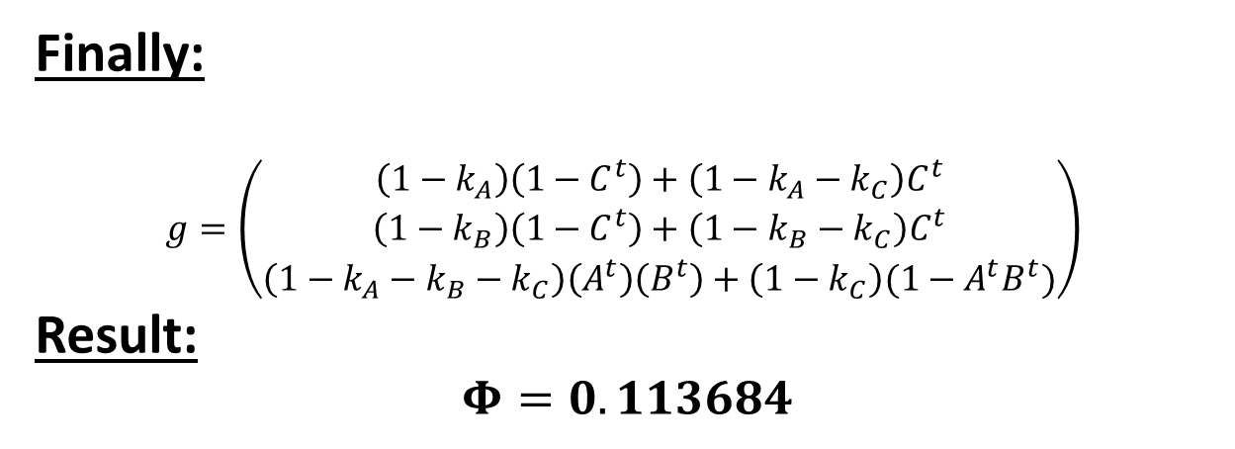
Simple Model
Slightly Better Choice:
$$f= \left(\begin{matrix}{Pα}^{t}\left(1−{Pβ}^{t}\right)+{Pα}^{t}{Pβ}^{t}{(1−B^{t})C}^{t} \\ {(1−Pα}^{t}){Pβ}^{t}+{Pα}^{t}{Pβ}^{t}{(1−A^{t})C}^{t} \\ {Pα}^{t}{Pβ}^{t}+{Pα}^{t}\left(1−{Pβ}^{t}\right)A^{t}+{(1−Pα}^{t}){Pβ}^{t}B^{t}\end{matrix}\right)$$
Result:
$$Φ=0.\text{208252}$$
Finally:
$$g=\left(\begin{matrix}\left(1−k_{A}\right)\left(1−C^{t}\right)+\left(1−k_{A}−k_{C}\right)C^{t} \\ \left(1−k_{B}\right)\left(1−C^{t}\right)+\left(1−k_{B}−k_{C}\right)C^{t} \\ \left(1−k_{A}−k_{B}−k_{C}\right)\left(A^{t}\right)\left(B^{t}\right)+\left(1−k_{C}\right)({1−A}^{t}B^{t})\end{matrix}\right)$$
Result:
$$Φ=0.113684$$

Slide 21
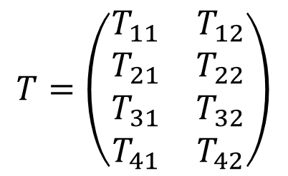
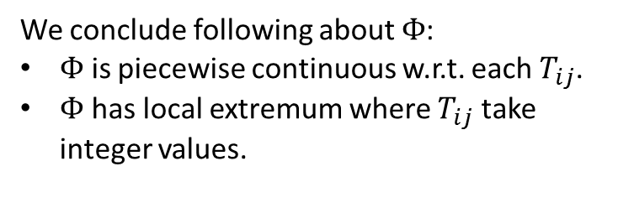
IIT in a 2 node system
A
B
We identify for each 2 node system a unique $4×2$ matrix.
We conclude following about $Φ$:
$Φ$ is piecewise continuous w.r.t. each $T_{ij}$.
$Φ$ has local extremum where $T_{ij}$ take integer values.
$$T=\left(\begin{matrix}T_{11} & T_{12} \\ T_{21} & T_{22} \\ T_{31} & T_{32} \\ T_{41} & T_{42}\end{matrix}\right)$$

Slide 22

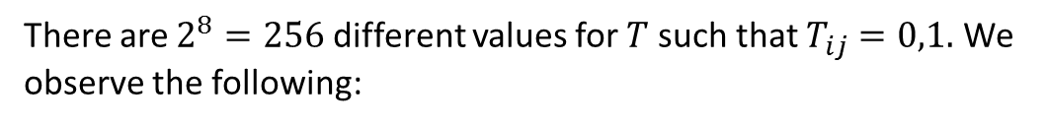
IIT in a 2 node system
Exhaustive Search
There are $2^{8}=256$ different values for $T$ such that $T_{ij}=0,1.$ We observe the following:
00
01
$$Φ=1.5$$
10
11

Slide 23
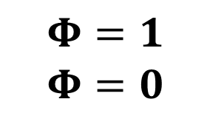
IIT in a 2 node system
00
01
$$Φ=1$$
$$Φ=0$$
10
11
A
!Copy
Reducible
B
Xor

Slide 24
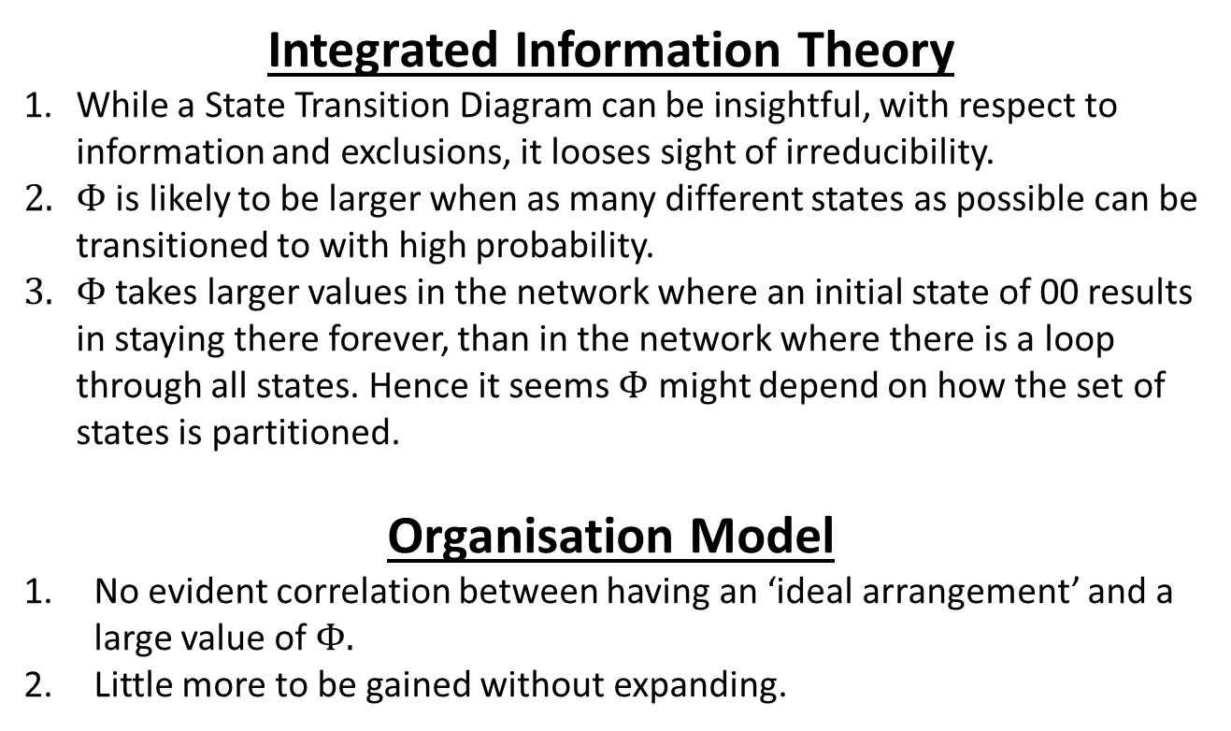
Conclusions
Integrated Information Theory
While a State Transition Diagram can be insightful, with respect to information and exclusions, it looses sight of irreducibility.
$Φ$ is likely to be larger when as many different states as possible can be transitioned to with high probability.
$Φ$ takes larger values in the network where an initial state of 00 results in staying there forever, than in the network where there is a loop through all states. Hence it seems $Φ$ might depend on how the set of states is partitioned.
Organisation Model
No evident correlation between having an ‘ideal arrangement’ and a large value of $Φ.$
Little more to be gained without expanding.

Slide 25
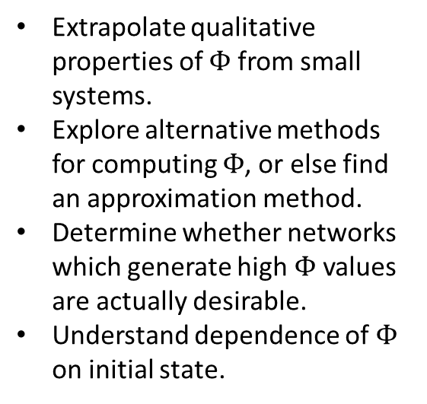
Future Work
Investigation of IIT
Development of Model
Extrapolate qualitative properties of $Φ$ from small systems.
Explore alternative methods for computing $Φ$, or else find an approximation method.
Determine whether networks which generate high $Φ$ values are actually desirable.
Understand dependence of $Φ$ on initial state.
Introduce notion of teams collaborating.
Add value to projects, and costs to the existence of teams and collaborations.
Allow the network two time scales over which it evolves.

